Slide 1

PROJEKTPRÄSENTATION SOFTWARE ENGINEERING
Gruppe 4: Tom Georgi und
Lukas Rohloff

Slide 2
| Gliederung
Schach Regeln
Version Control System
Scrum
Layers and MVC
Code Coverage
Travis CI
Design Patterns
Components and Interfaces
Dependency Injection
FILE IO in JSON and XML
Documentation
TUI
GUI

Slide 3
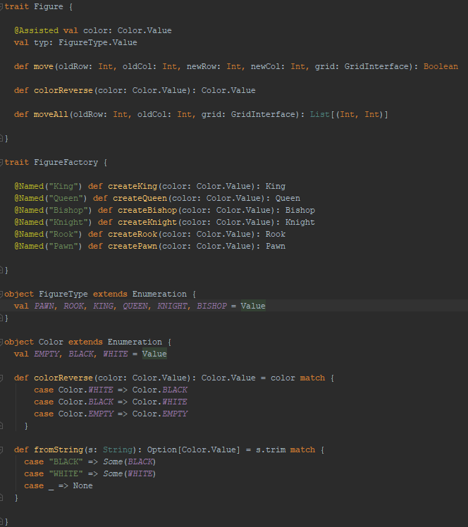
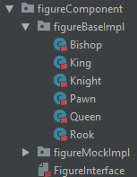
| CHESS RULES
Aufbau des figure interface und implementierung der einzelnen regeln

Slide 4
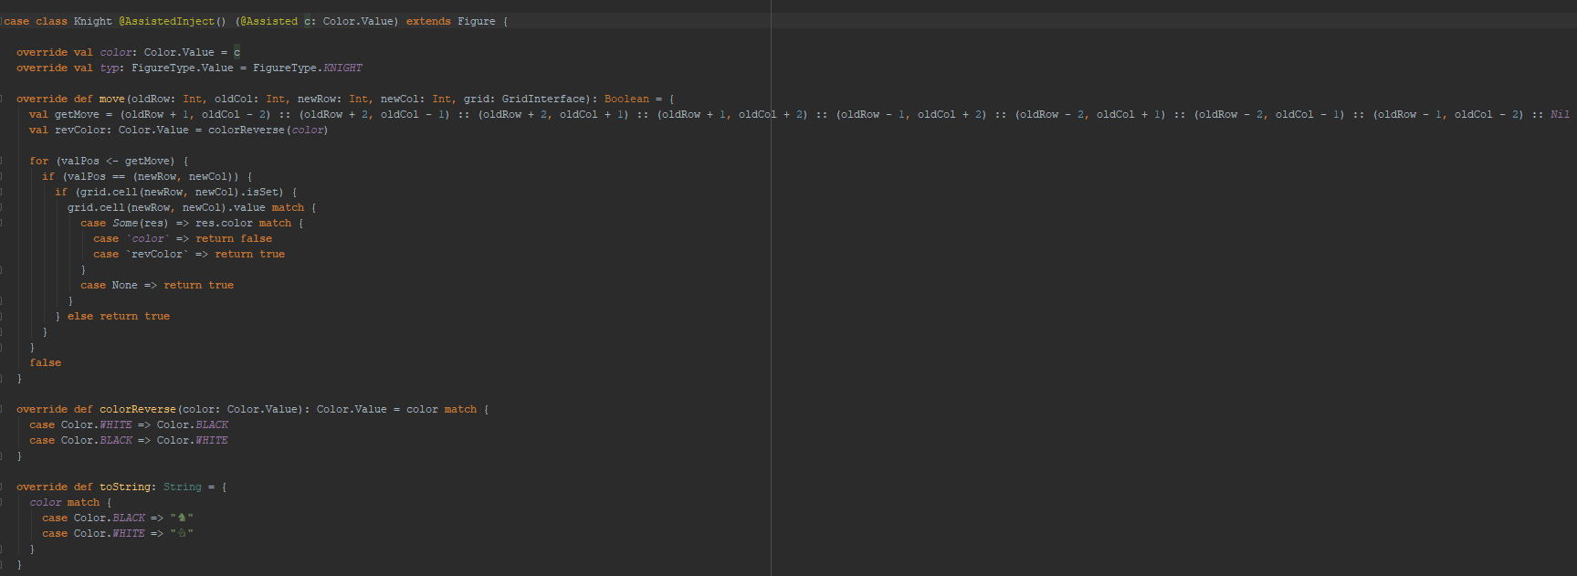

Slide 5
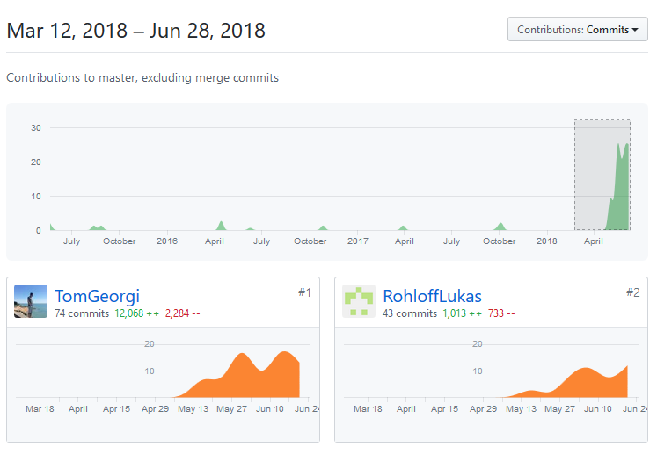
| Version control system
| CONTRIBUTIONS

Slide 6
| Version Control System
| NETWORK GRAPH

Slide 7
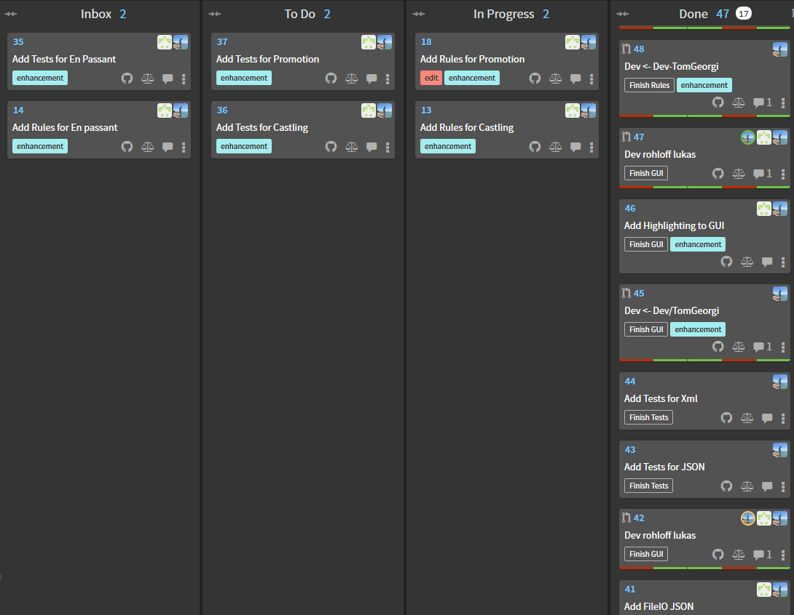
| SCRUM
| Board View

Slide 8
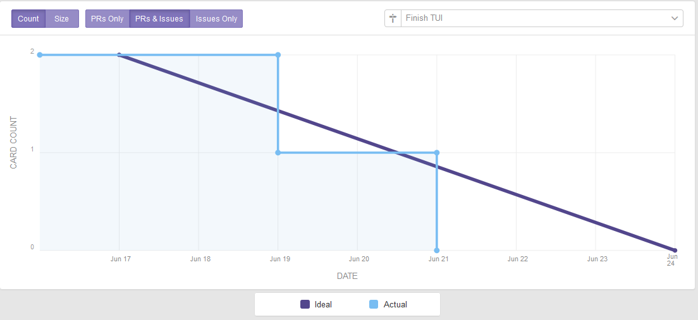
| Scrum
| BURNDOWN GRAPHEN

Slide 9
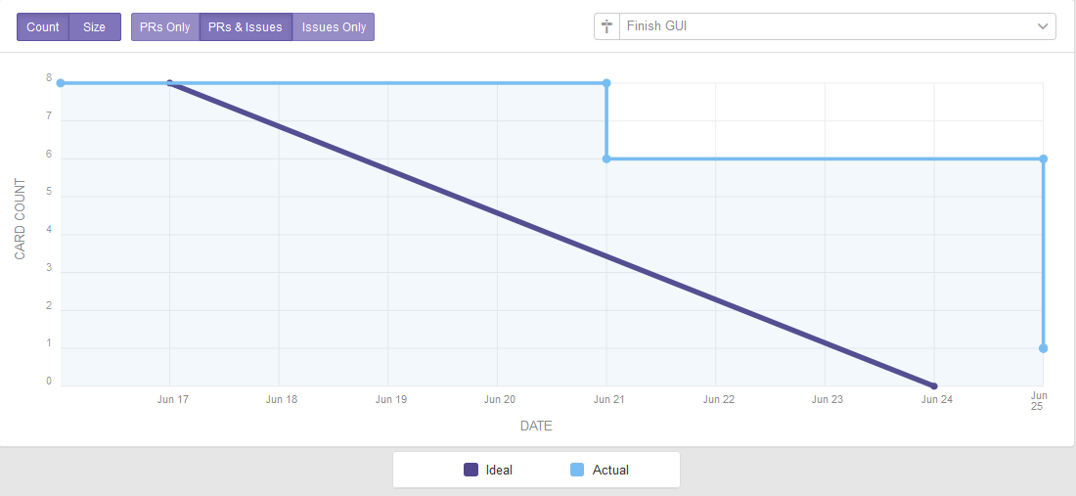
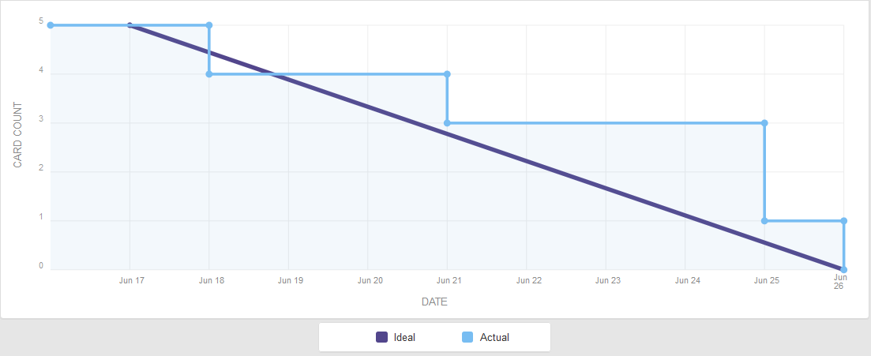

Slide 10
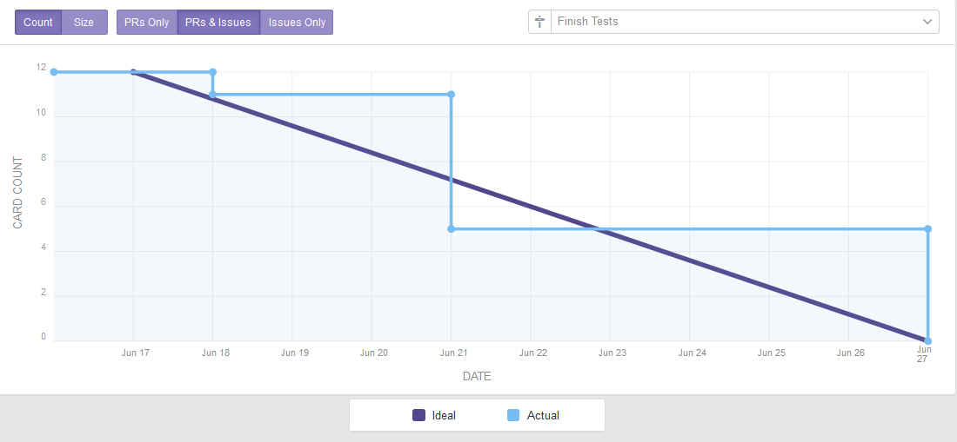
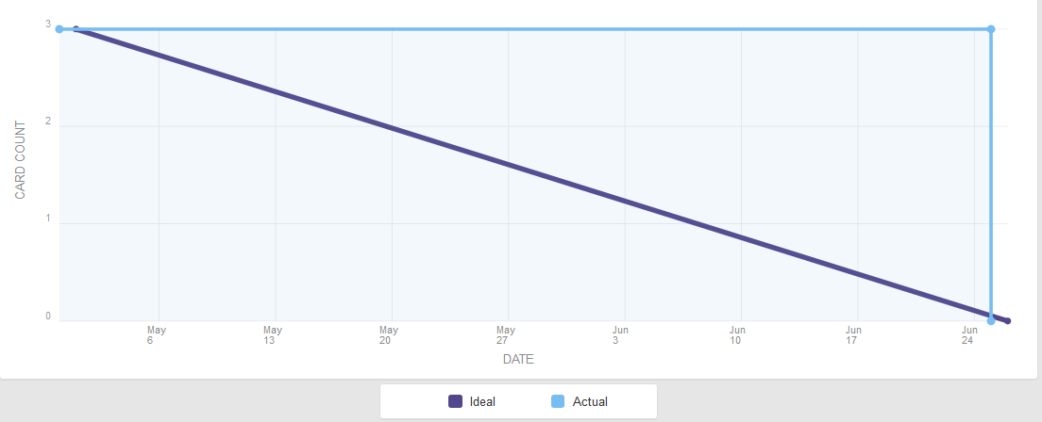

Slide 11
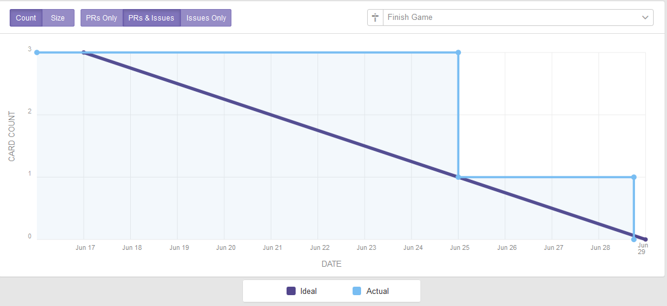

Slide 12
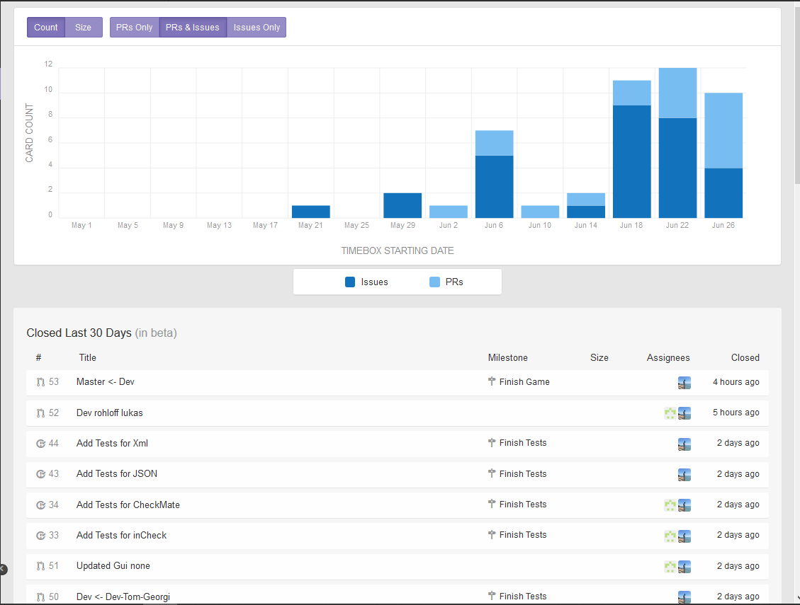
| Scrum
| THROUGHPUT GRAPH

Slide 13
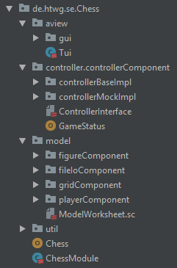
| Layers and mvc

Slide 14
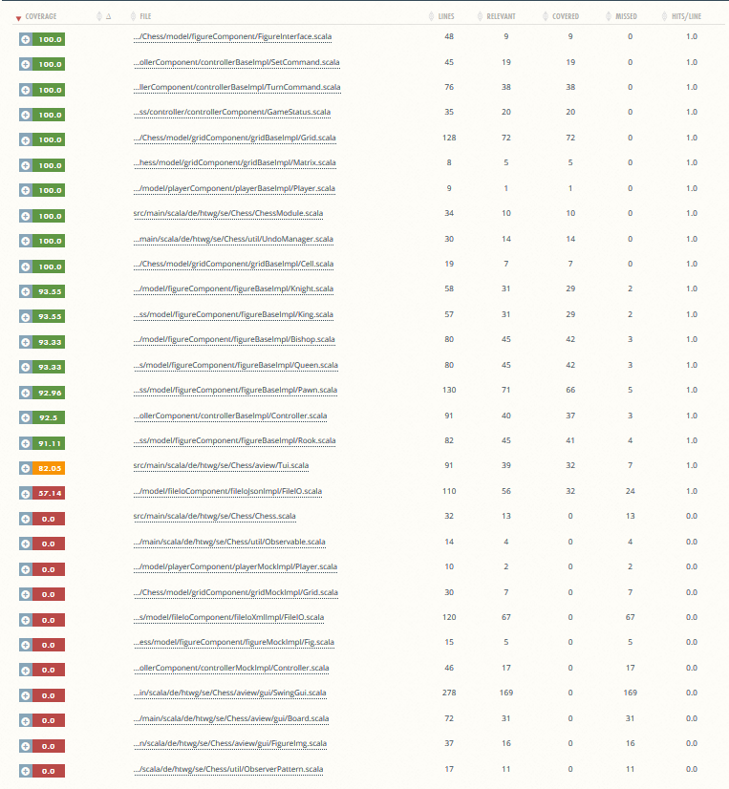
| code coverage

Slide 15
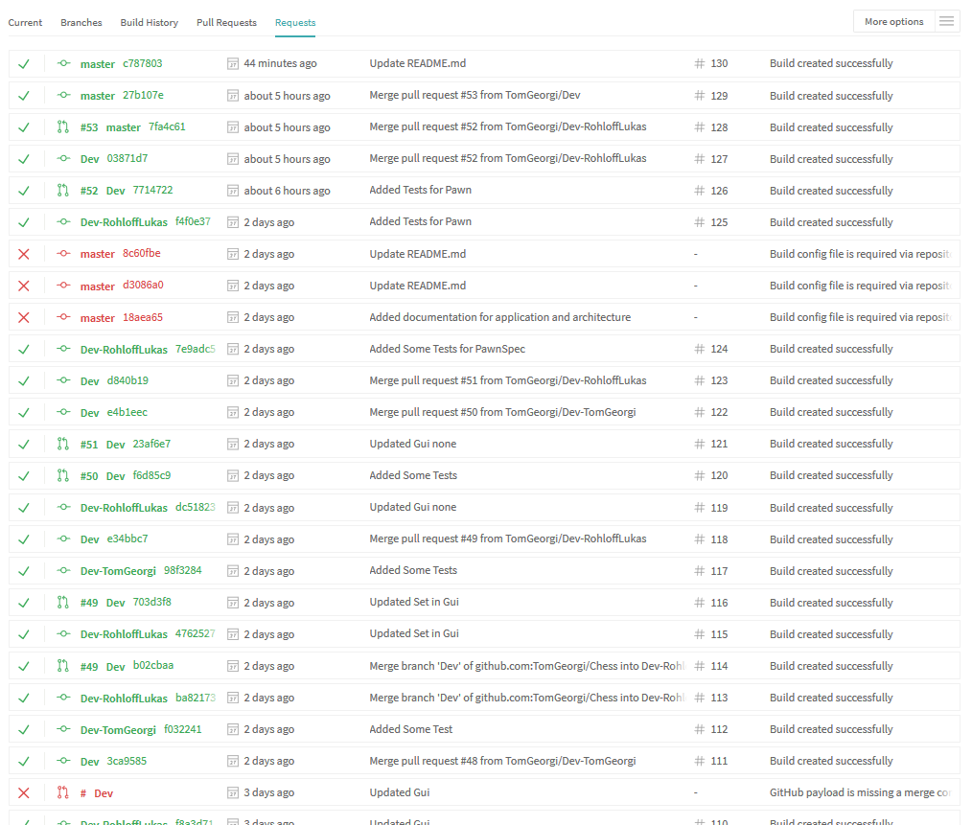
| Continuous integration

Slide 16
| Design patterns
Observer Pattern (for MVC)
Command Pattern (do, undo and redo)
Factory Pattern (used for Dependency Injection)

Slide 17
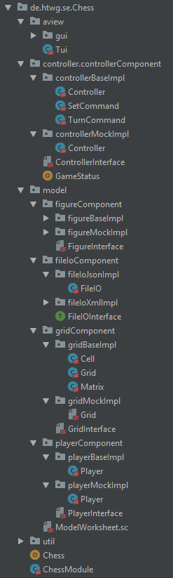
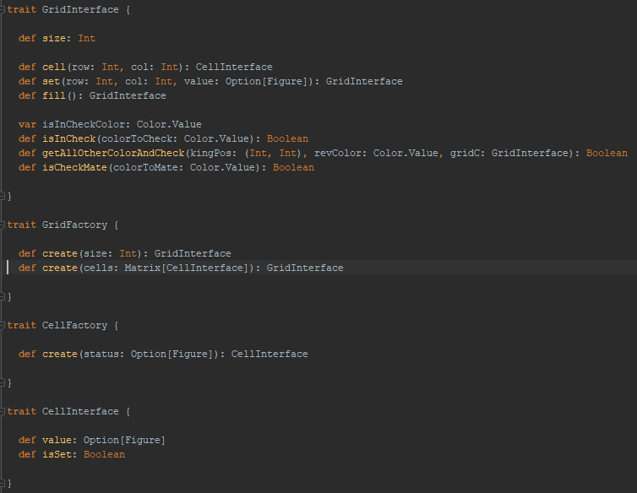
| components and interfaces

Slide 18
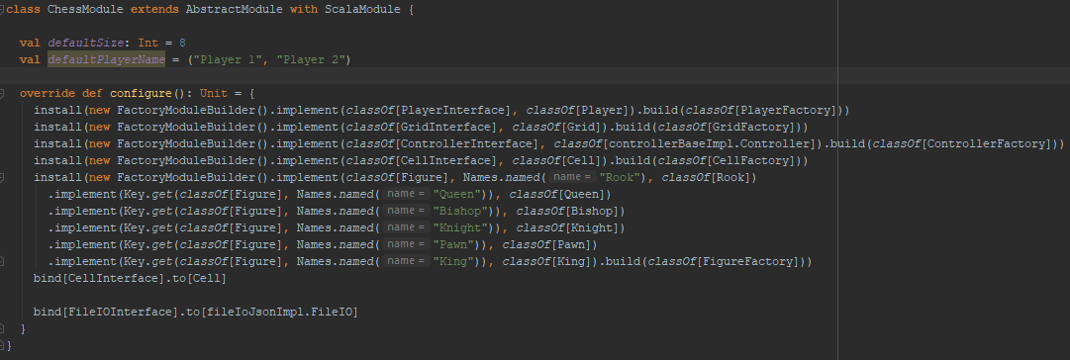
| dependency injection

Slide 19
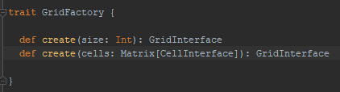
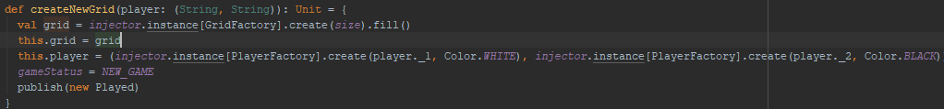
| Dependency injection
| CREATE INJECTOR , FACTORY BSP & EXAMPLE

Slide 20
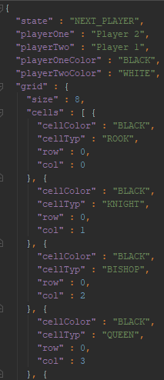
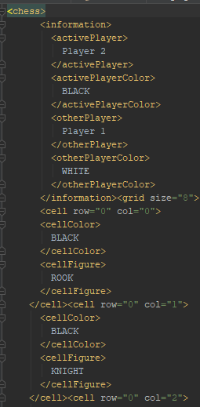
| file io in json and xml

Slide 21
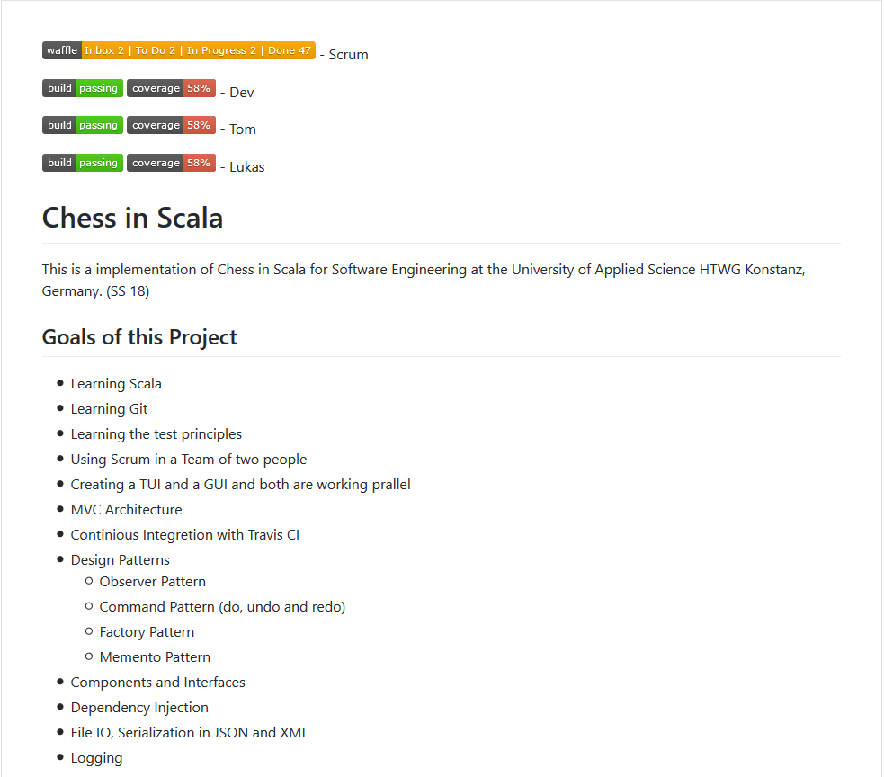
| documentation

Slide 22
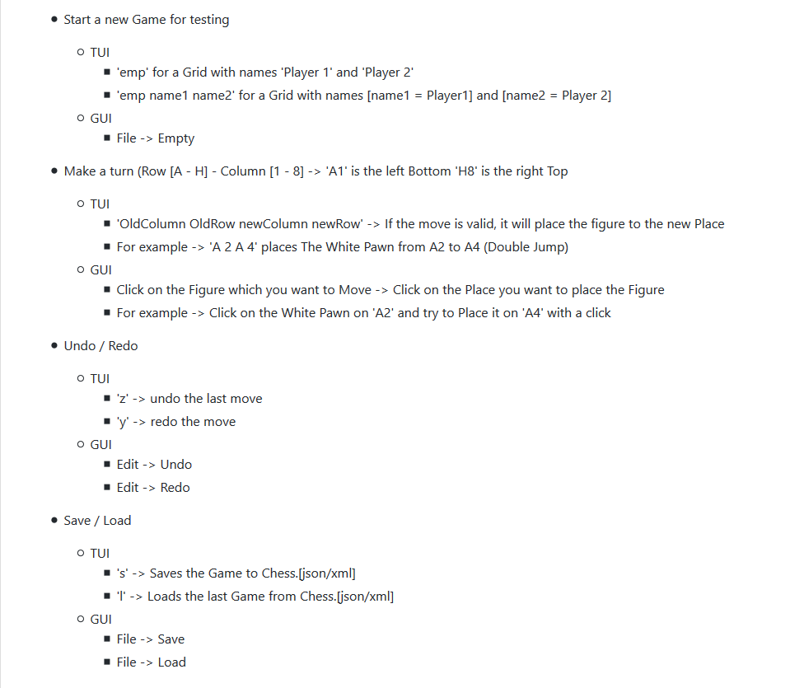
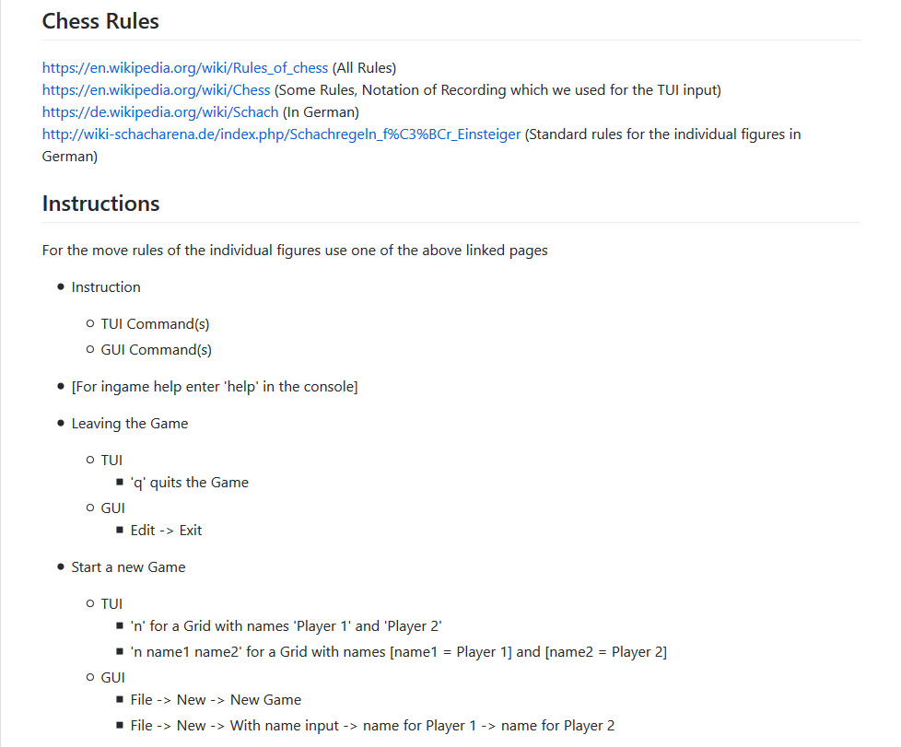

Slide 23
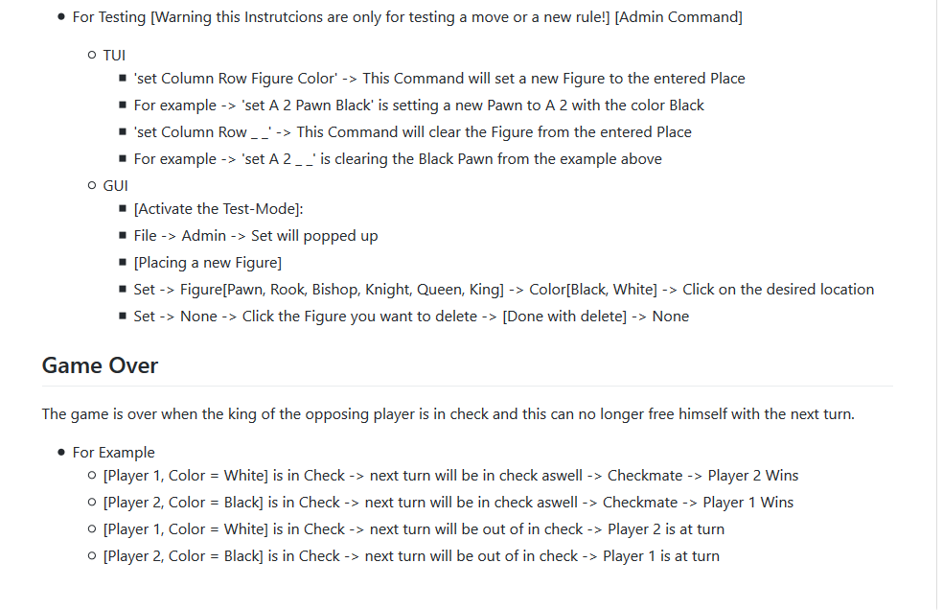

Slide 24
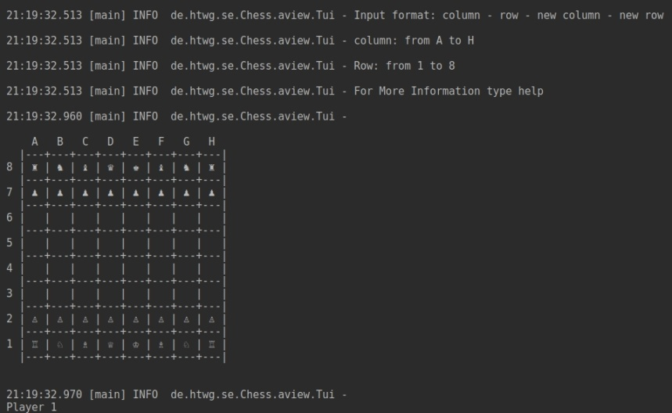
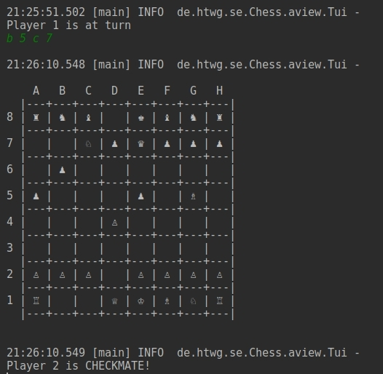
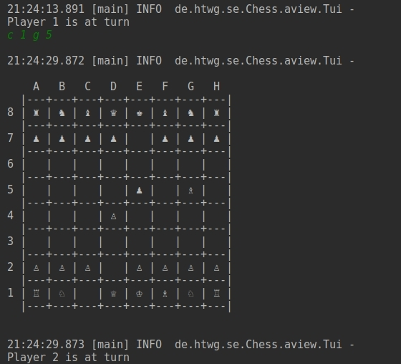
| tui development

Slide 25
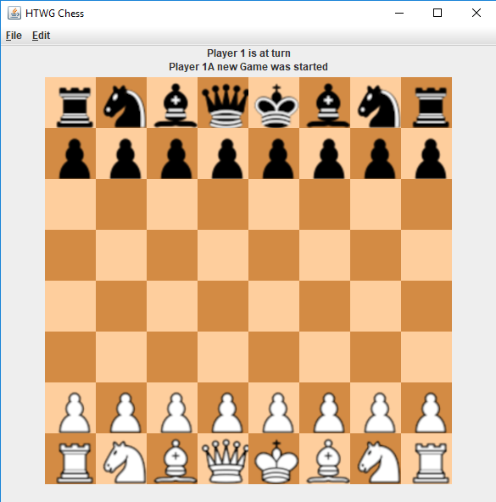
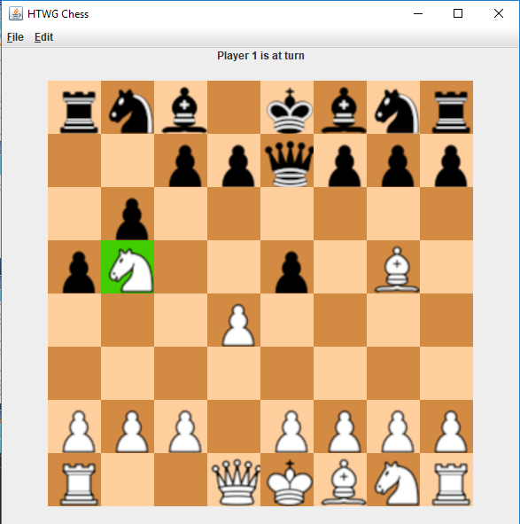
| GUI Development

Slide 26
